Slide 1
Merge sort

Slide 2
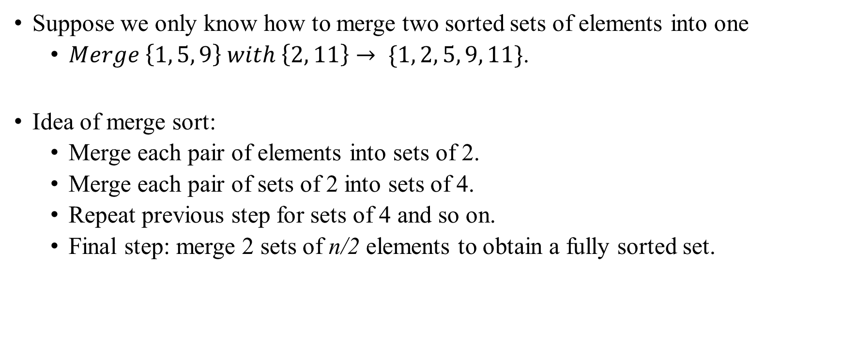
Merge Sort
Idea

Slide 3
Merge Sort
Divide and Conquer method
A powerful problem solving technique.
Divide-and-conquer method solves problem in the following steps:
Divide step:
Divide the large problem into smaller problems.
Recursively solve the smaller problems.
Conquer step:
Combine the results of the smaller problems to produce the result of the larger problem.

Slide 4
Merge Sort
Divide and Conquer method
Merge Sort is a divide-and-conquer sorting algorithm.
Divide step:
Divide the array into two (almost equal) halves.
Recursively sort the two halves.
Conquer step:
Merge the two halves to form a sorted array.

Slide 5
Merge Sort
Divide and Conquer method
7 | 2 | 6 | 3 | 8 | 4 | 5
Divide into two halves
7 | 2 | 6 | 3
8 | 4 | 5
Recursively sort the halves
2 | 3 | 6 | 7
4 | 5 | 8
Merge them
2 | 3 | 4 | 5 | 6 | 7 | 8

Slide 6
Merge Sort
Example
38 | 16 | 27 | 39 | 12 | 27
38 | 16 | 27
39 | 12 | 27
Divide Phase: Recursive call to mergeSort().
38 | 16
27
39 | 12
27
12
38
39
16
16 | 38
12 | 39
Conquer phase:
Merge steps.
16 | 27 | 38
12 | 27 | 39
12 | 16 | 27 | 27 | 38 | 39

Slide 7
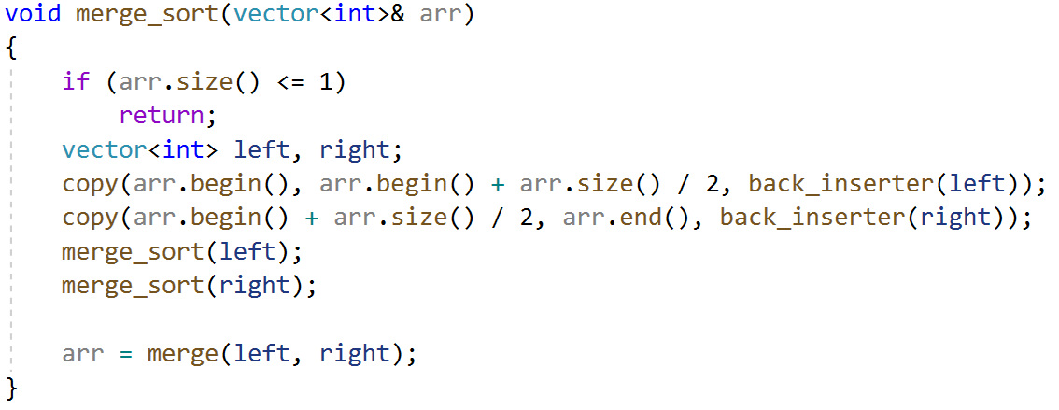
Merge Sort
Implementation

Slide 8
Merge Sort
Merge example
2 | 4 | 5
3 | 7 | 8
We want to merge 2 sorted arrays

Slide 9
Merge Sort
Merge example
2 | 4 | 5
3 | 7 | 8
2
On the first step we take first element from first array, because 2 < 3

Slide 10
Merge Sort
Merge example
2 | 4 | 5
3 | 7 | 8
2 | 3
Then first element from second array

Slide 11
Merge Sort
Merge example
2 | 4 | 5
3 | 7 | 8
2 | 3 | 4
Then second element from first array

Slide 12
Merge Sort
Merge example
2 | 4 | 5
3 | 7 | 8
2 | 3 | 4 | 5
Then third element from first array

Slide 13
Merge Sort
Merge example
2 | 4 | 5
3 | 7 | 8
2 | 3 | 4 | 5
First array has ended, so simply add the remained part of second array to our merged array

Slide 14
Merge Sort
Merge example
2 | 4 | 5
3 | 7 | 8
2 | 3 | 4 | 5 | 7 | 8
First array has ended, so simply add the remained part of second array to our merged array

Slide 15
Merge Sort
Merge example
2 | 4 | 5
3 | 7 | 8
2 | 3 | 4 | 5 | 7 | 8
Arrays merged

Slide 16
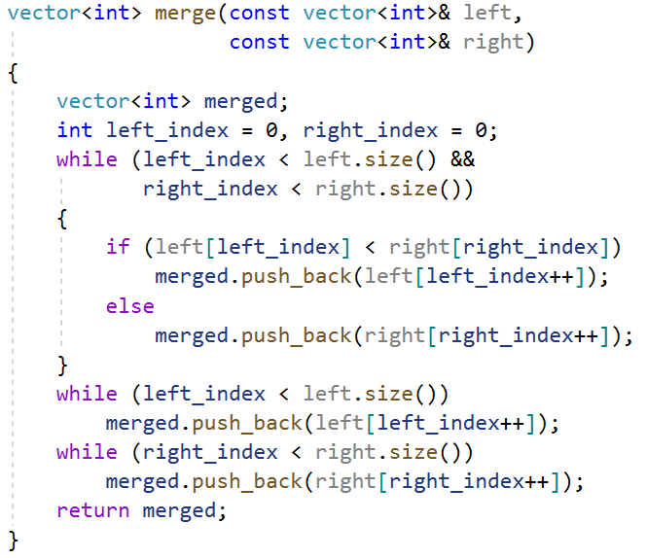
Merge Sort
Merge implementation

Slide 17
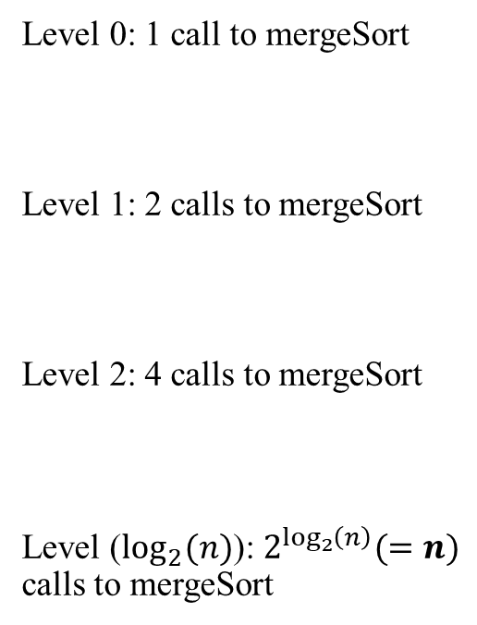
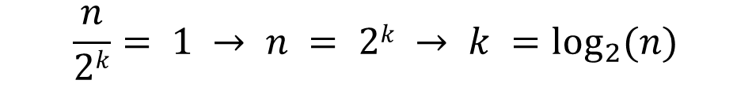
Merge Sort
Analysis
Level 0: mergeSort n items
Level 1: mergeSort n/2 items
Level 2: mergeSort n/4 items
Level (lg n): mergeSort 1 item
n
n/2
n/2
n/4
n/4
n/4
n/4
…
1
1
1
1

Slide 18
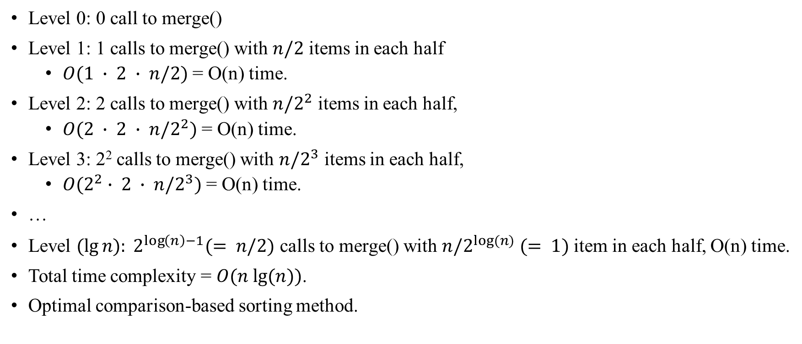
Merge Sort
Analysis

Slide 19
Merge Sort
Pros and Cons
Pros:
The performance is guaranteed, i.e. unaffected by original ordering of the input.
Suitable for extremely large number of inputs, can operate on the input portion by portion.
Cons:
Requires additional storage during merging operation.
O(n) extra memory storage needed.

